Slide 1
Lecture Notes #6
Antennas and Propagation

Slide 2
Introduction
An antenna is a transducer that converts radio frequency electric current to electromagnetic waves that are radiated into space
In two-way communication, the same antenna can be used for transmission and reception

Slide 3
Fundamental Antenna Concepts
Reciprocity
Radiation Patterns
  Isotropic Radiator
Gain
Polarization

Slide 4
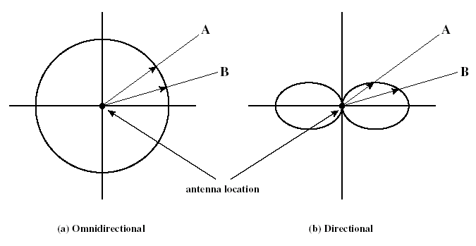
Radiation Patterns
Radiation pattern
  Graphical representation of radiation properties of an antenna
  Depicted as a two-dimensional cross section
Reception pattern
  Receiving antenna’s equivalent to radiation pattern

Slide 5
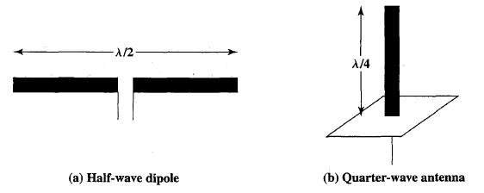
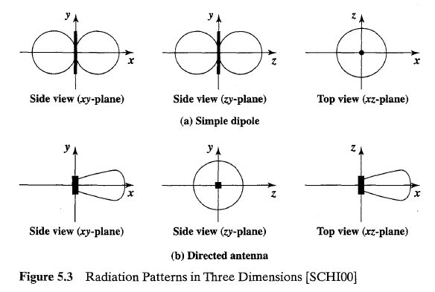

Slide 6
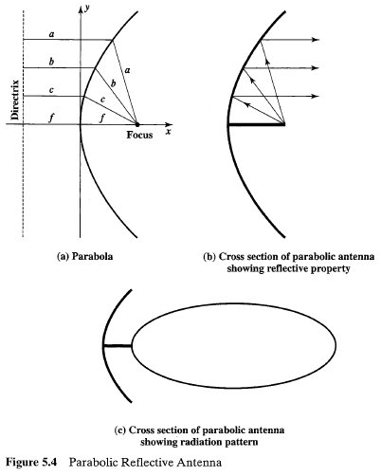

Slide 7
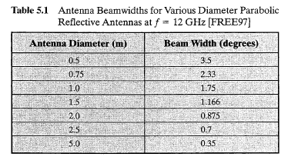
Note that the larger the diameter of the antenna, the more tightly directional is the beam.

Slide 8
Antenna Gain
Antenna gain
  Power output, in a particular direction, compared to that produced in any direction by an isotropic antenna(perfect omnidirectional antenna)
Effective area
  Related to physical size and shape of the antenna

Slide 9

Antenna Gain (cont.)
Relationship between antenna gain and effective area
    G → antenna gain
    A_{e} → effective area
    f → carrier frequency
    c → speed of light (≈ 3 x 10⁸ m/s)
    λ → carrier wavelength

Slide 10
Antenna Gain (cont.)
An antenna with a G = 3dB improves over the isotropic antenna in that direction by 3dB or a factor of 2

Slide 11
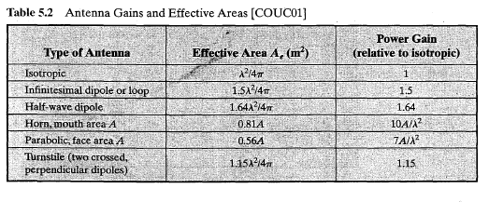


Slide 12
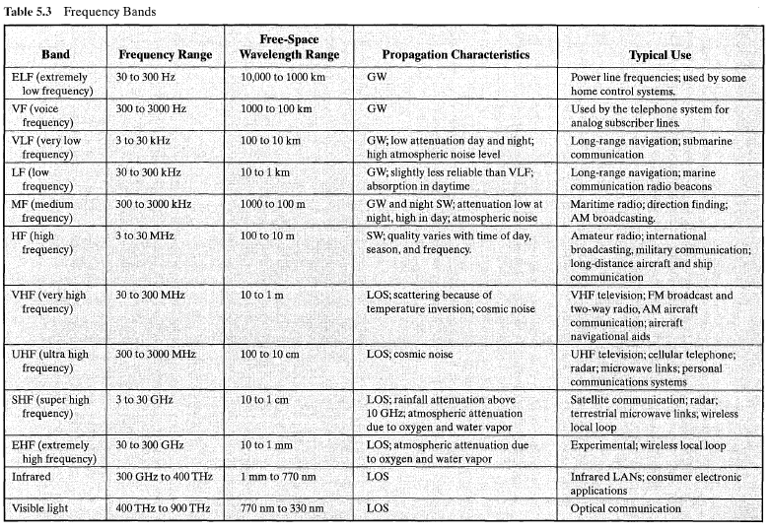
Frequency Bands

Slide 13
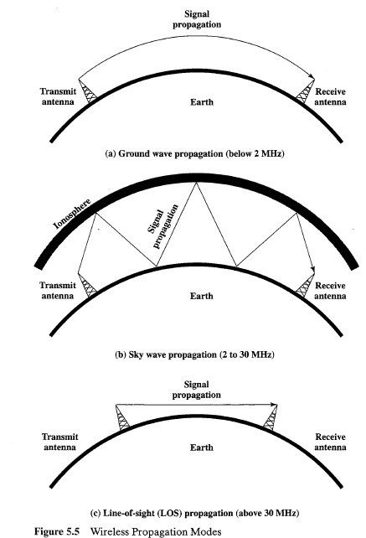

Slide 14
Types of Antennas
Isotropic antenna
  Idealized
  Radiates power equally in all directions
    Omnidirectional
Dipole antennas
  Half-wave dipole antenna
    Hertz antenna
  Quarter-wave vertical antenna
    Marconi antenna
Parabolic Reflective Antenna

Slide 15
Propagation Modes
Ground-wave propagation
Sky-wave propagation
Line-of-sight propagation

Slide 16
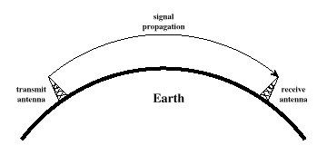
Ground Wave Propagation
Follows contour of the earth
Can propagate considerable distances
Frequencies up to 2 MHz
Example
  AM radio

Slide 17
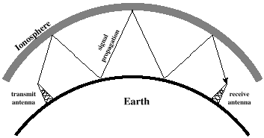
Sky Wave Propagation
Signal reflected from ionized layer of atmosphere back down to earth
Signal can travel a number of hops, back and forth between ionosphere and earth’s surface
Reflection effect caused by refraction
Examples
  Amateur radio
  CB radio

Slide 18
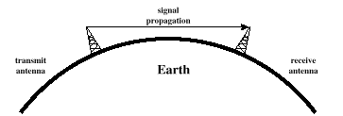
Line-of-Sight Propagation
Transmitting and receiving antennas must be within line of sight
Refraction
  Bending of microwaves by the atmosphere
  Velocity of electromagnetic wave is a function of the density of the medium
  When wave changes medium, speed changes
  Wave bends at the boundary between mediums

Slide 19
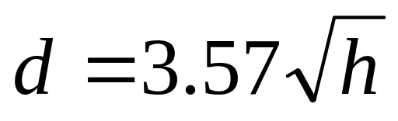
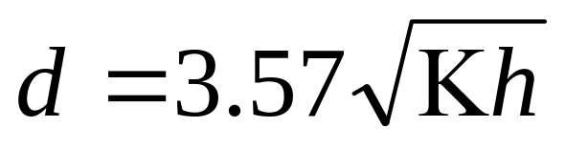
Line-of-Sight Equations
Optical line of sight
Effective (or radio) line of sight
    d = distance between antenna and horizon (km)
    h = antenna height (m)
    K = adjustment factor to account for refraction, rule of thumb K = 4/3

Slide 20
LOS Wireless Transmission Impairments
Attenuation and attenuation distortion
Free space loss
Noise
Atmospheric absorption
Multipath
Refraction
Thermal noise

Slide 21
Attenuation
Strength of signal falls off with distance over transmission medium
Attenuation factors for unguided media:
  Received signal must have sufficient strength so that circuitry in the receiver can interpret the signal
  Signal must maintain a level sufficiently higher than noise to be received without error
  Attenuation is greater at higher frequencies, causing distortion

Slide 22
Free Space Loss
For satellite communication this is the primary mode of signal loss.
Even if no other sources of attenuation or impairment are assumed, a transmitted signal attenuates over distance because the signal is being spread over a larger and larger area. This form of attenuation is known as free space loss

Slide 23

Free Space Loss
Free space loss → Ideal isotropic antenna
    P_{t} = signal power at transmitting antenna
    P_{r} = signal power at receiving antenna
    λ = carrier wavelength
    d = propagation distance between antennas
    c = speed of light (≈ 3 x 10⁸ m/s)
    where d and λ are in the same units (e.g., meters)

Slide 24
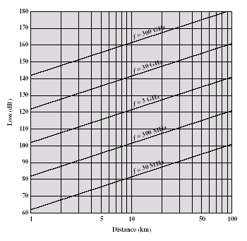
Free Space Loss

Slide 25

Free Space Loss
Free space loss accounting for gain of other antennas
    G_{t} = gain of transmitting antenna
    G_{r} = gain of receiving antenna
    A_{t} = effective area of transmitting antenna
    A_{r} = effective area of receiving antenna

Slide 26
Categories of Noise
Thermal Noise
Intermodulation noise
Crosstalk
Impulse Noise

Slide 27
Thermal Noise
Thermal noise due to agitation of electrons
Present in all electronic devices and transmission media
Cannot be eliminated
Function of temperature
Particularly significant for satellite communication

Slide 28
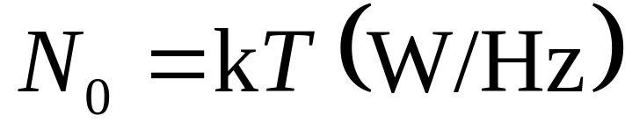
Thermal Noise
Amount of thermal noise to be found in a bandwidth of 1Hz in any device or conductor is:
    N₀ = noise power density in watts per 1 Hz of bandwidth
    k = Boltzmann's constant = 1.3803 × 10⁻²³ J/ºK
    T = temperature, in kelvins (absolute temperature)

Slide 29
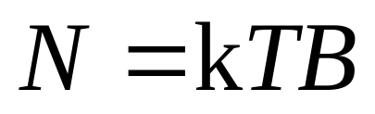
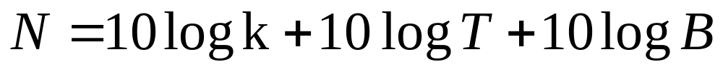
Thermal Noise
Noise is assumed to be independent of frequency
Thermal noise present in a bandwidth of B Hertz (in watts):
or, in decibel-watts

Slide 30
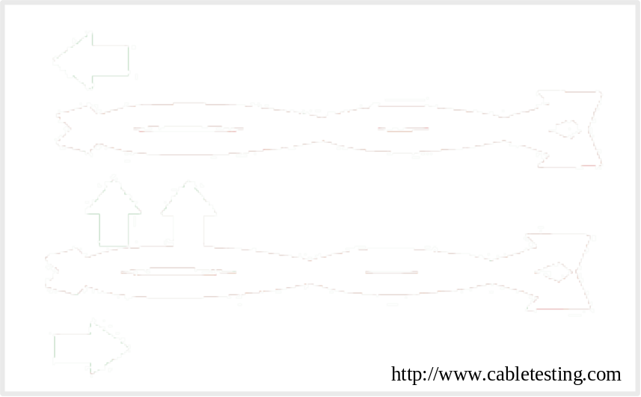
Noise Terminology
Intermodulation noise
  Occurs if signals with different frequencies share the same medium
Crosstalk
  Unwanted coupling between signal paths

Slide 31
Noise Terminology
Impulse noise
  Irregular pulses or noise spikes
  Short duration and of relatively high amplitude
  Caused by external electromagnetic disturbances, or faults and flaws in the communications system

Slide 32
Other Impairments
Atmospheric absorption
  Water vapor and oxygen contribute to attenuation
Multipath
  Obstacles reflect signals so that multiple copies with varying delays are received
Refraction
  Bending of radio waves as they propagate through the atmosphere

Slide 33
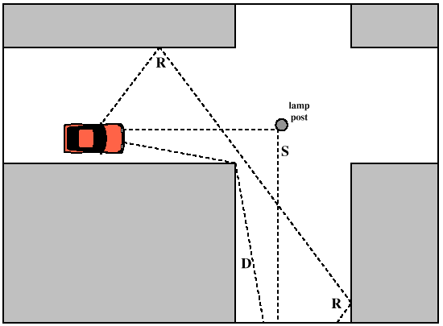
Fading in Mobile Environment
Fading
  Time variation of received signal power caused by changes in transmission medium or path(s)

Slide 34
Multipath Propagation (MP)
Reflection
  Occurs when signal encounters a surface that is large relative to the wavelength of the signal
Diffraction
  Occurs at the edge of an impenetrable body that is large compared to wavelength of radio wave
Scattering
  Occurs when incoming signal hits an object whose size is in the order of the wavelength of the signal or less

Slide 35
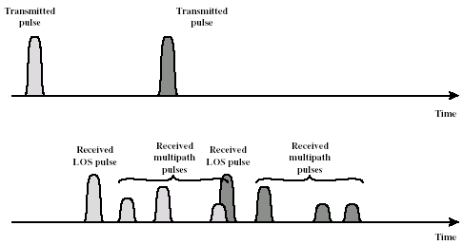
The Effects of MP Propagation
Multiple copies of a signal may arrive at different phases
  If phases add destructively, the signal level relative to noise declines, making detection more difficult
  Known as Intersymbol Interference (ISI)

